Slide 1
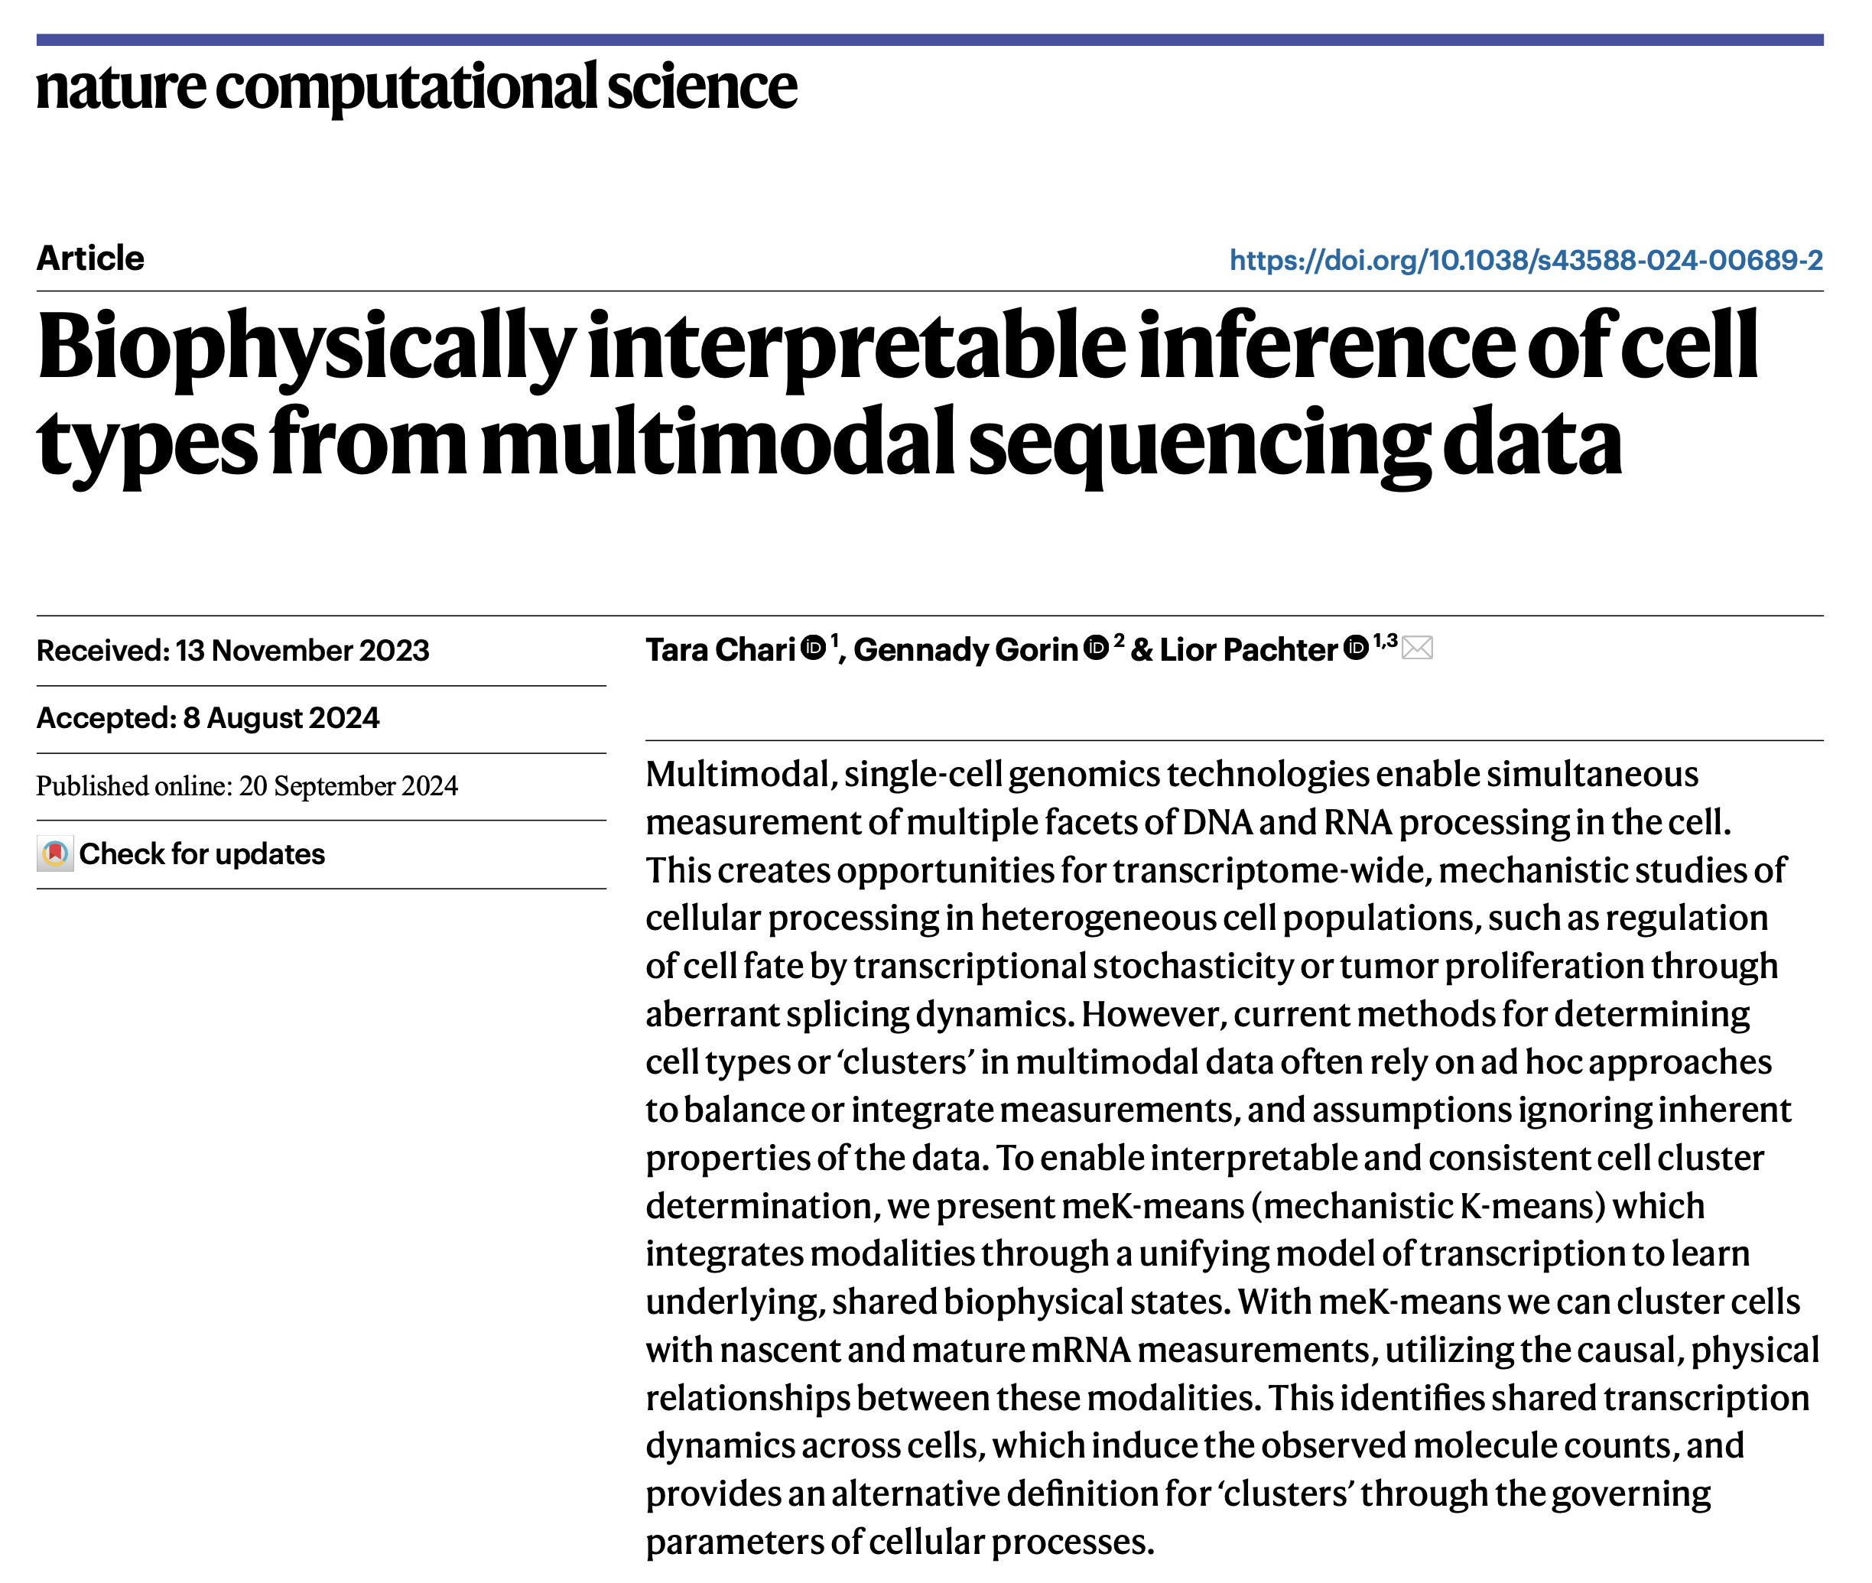
Journal club
12-17-2024
Ty Bottorff
Notes:
mechanistic K-means (meK-means) as a method to cluster cells from multimodal single-cell data under a self-consistent, biophysical model

Slide 2
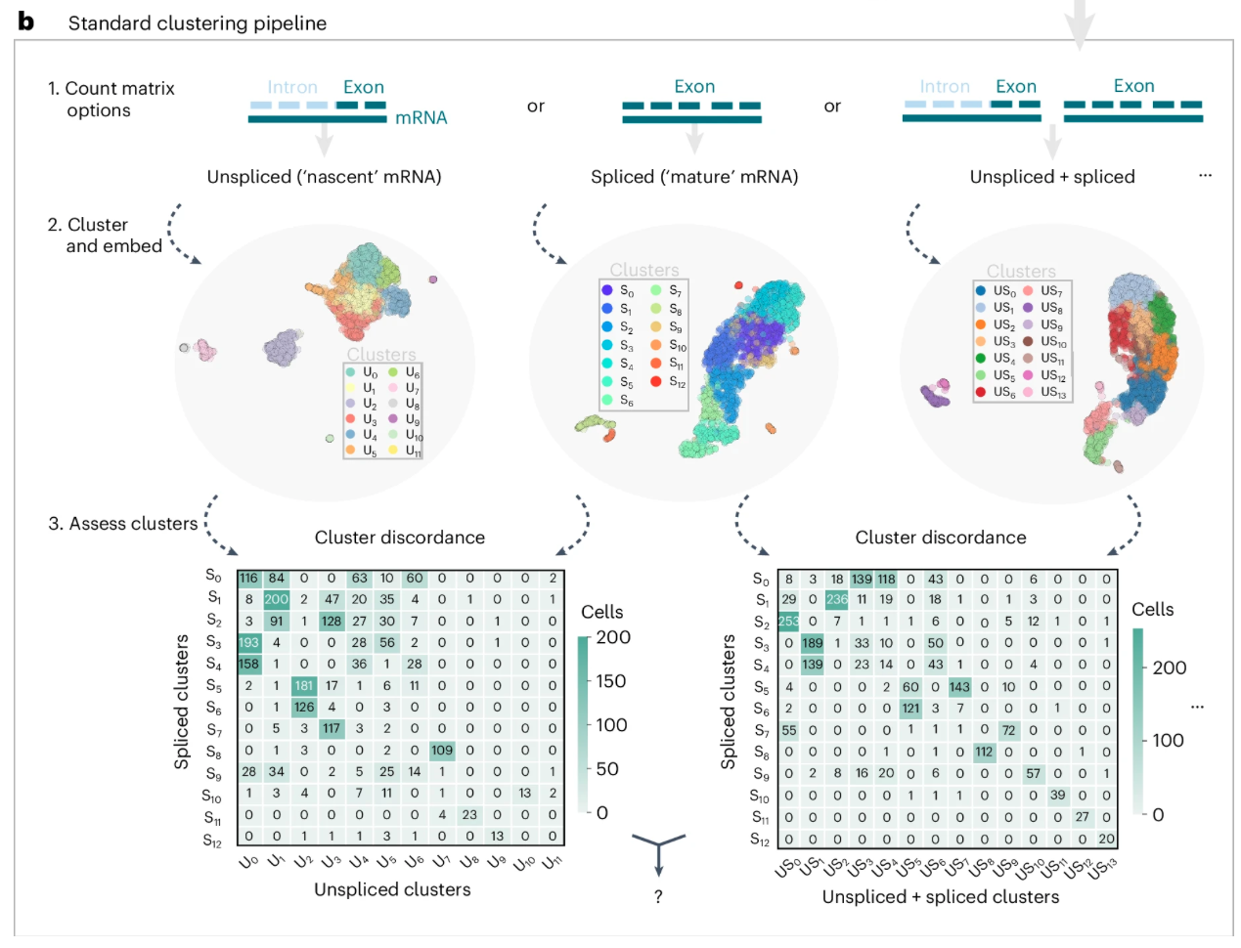
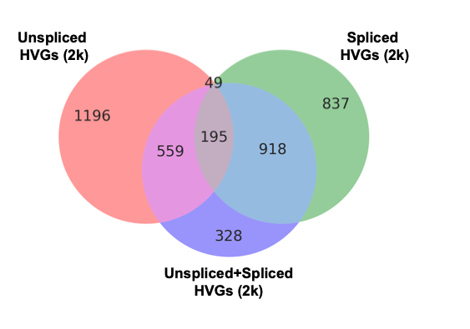
Modality choice impacts clustering, variable genes
Notes:
There’s an open problem (denoted by ?) of resolving clusters obtained from different modalities
the common practice of selecting HVGs from spliced expression may not be ideal, particularly if variability exists in another modality.
In cluster discordance (confusion) matrices, can see counts of cells overlapping between pairs of clustering results, so can see for example how a specific unspliced cluster is split between various spliced clusters (and vice versa)
Existing multimodal approaches largely ignore unspliced RNA counts
U and S are summed by default in the 10× Genomics Cell Ranger v.7.0.0 pipeline
Deep learning approaches^{32,33} do often use discrete distributions to represent data, but model modalities as independent observational distributions despite their innate causal, transcriptional relationships. It then remains unclear how to interpret the balance of modalities in such latent spaces
methods that do utilize U build on RNA velocity pipelines³⁴, which rely on large numbers of arbitrary hyperparameters and ad hoc processing steps³⁵ that are often incompatible with known biophysics
It is rare to only cluster on intronic reads, but can still appreciate only exonic vs. exonic + intronic differences in clustering
Really focus on U/S here which isn’t really multimodal, and was left really craving true multimodal editable CME (like ATAC/RNA…, or RNA/protein…)

Slide 3
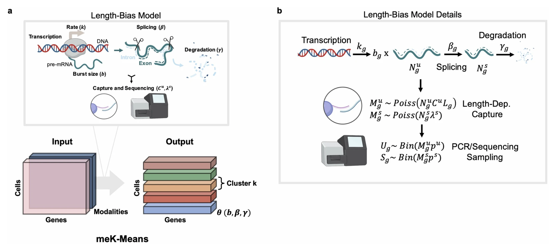
Length-bias Chemical Master Equation (CME) model
Notes:
3’ seq doesn’t have template switching so misprimed internal polyA seqs unlikely captured/sequenced…
CME describes probability of molecule (for example spliced and unspliced) counts X over time (p(X, t)) (for example for a specific gene) given some rates of transitions between states (possible molecular counts, rates are gene-specific and describe transcription, splicing, degrdation). Good for low-count (discrete) systems like scRNAseq (sparse), extensively used in fluorescence transcriptomics field
transcription k_{g} (which produces unspliced molecules in bursts of size b_{g}; b_{g} represents the mean of geometrically distributed bursts of transcription⁶⁴), splicing of unspliced molecules (β_{g}) and degradation of spliced molecules (γ_{g})
Length-bias CME model developed for polyA capture scRNAseq methods like 10x that biases to capturing more longer transcripts (that have more internal polyA for capture)
Model includes sampling of molecules outside biology (i.e. sequencing-based sampling). length-dependent technical sampling (C, λ, p) of the biological molecules (N^{u}, N^{s}) produced by the transcription processes, which occurs during the sequencing process. Length-dependent capture produces the counts M^{u}, M^{s} and the final sequencing-based sampling produces the observed counts U, S, representing the final cell x gene count matrices
Input modalities and output matrix of cluster X genes X parameters (like transcription rate k, burst size b, splicing beta, degradation gamma). meK-means fits data to Length-Bias Model of transcription
Rates per gene g denoted.
working with snapshot scRNA-seq data, we study the behavior of p(U_{g}, S_{g}, t), in the long-time limit (steady-state), p(U_{g}, S_{g}) as t → ∞. At the steady-state, certain gene parameters are not independently identifiable, we therefore define relative splicing and degradation parameters, β_{g}/k_{g} and γ_{g}/k_{g}, where splicing and degradation rates, respectively, are relative to the transcription rate k_{g} (ref. ³⁸). The technical parameters, which are shared across genes, are shown in the Poisson and binomial distributions of the capture and sequencing sampling parameters in Extended Data Fig. 1b, and are also not independently identifiable; we therefore define net sampling rates λ^{u}, λ^{s} (where λ^{u} = C^{u}L_{g}, where L_{g} is the length of the gene), which contain p^{u}, p^{s}. For simulation and meK-means inference, these global technical parameters are set before data generation or inference of the physical parameters (that is, we do not perform a grid search over these parameters during meK-means inference)

Slide 4
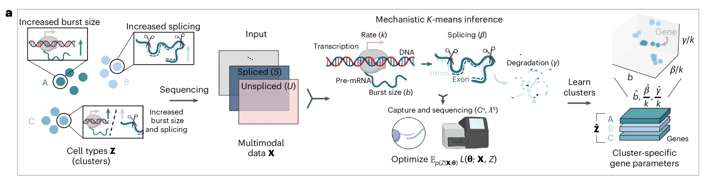
meK-means takes in (un)spliced RNA counts and clusters cells based on transcriptional dynamics
transcription rate k, mRNA burst size b, splicing rate β, and degradation of mRNA γ
Notes:
Mechanistic K-means models the joint distribution of these modalities using a biophysical model of their transcriptional relationships, and infers which cells cluster together based on similar transcription kinetics (Fig. 2a). The output of meK-means is a cluster × gene × parameters matrix, learning cluster-specific, biophysical parameters for each gene describing the processes of mRNA transcription, splicing and degradation (Fig. 2a).
meK-means on U and S counts, using the chemical master equation (CME) to define their discrete, joint distribution at steady-state³⁶ and formalize causal, transcriptional dynamics in the cell^{36,37,38} (see the ‘The CME model of sequencing data for meK-means’ section in the Methods). Mechanistic K-means then defines a mixture model over this joint distribution, learning clusters Z underlying the observed counts (see the ‘Mechanistic K-means algorithm and inference’ section in the Methods). Clusters are thus defined by the governing parameters of the cellular processes of interest, representing shared transcriptional programs between genes.
Mechanistic K-means takes two raw count matrices as input: the unspliced and spliced count matrices. Given these two modalities, a biophysical model of transcription connecting these unspliced and spliced counts is fit to the data, assuming that there are also underlying states (or clusters) of cells with different biophysical parameters, per gene
data generation and meK-means inference. Input: multimodal sequencing data with underlying states Z. Output: inferred states with state-specific biophysical parameters. The meK-means model defines underlying states with governing rates describing transcription and sequencing
we use the CME (see the ‘The CME model of sequencing data for meK-means’ in Methods; Extended Data Fig. 1) to define the joint distribution of U, S counts through kinetic rates of transcription, splicing and degradation, and molecule sampling during sequencing. Mechanistic K-means iteratively assigns cells to a cluster, and infers parameters that induce a joint distribution recapitulating the observed counts
Mechanistic K-means takes in a user-defined number of clusters, K, but can converge to fewer than K clusters if more are not discernible
The biophysical parameters inferred are the transcription burst size, relative splicing rate and relative degradation rate (relative to the rate of transcription k), respectively. The parameters for technical, length-biased sampling of nascent and mature mRNA molecules during sequencing (see the ‘Capture and sequencing’ section of Fig. 2a) are determined before biophysical parameter inference
At the steady-state, certain gene parameters are not
independently identifiable, we therefore define relative splicing and
degradation parameters, βg/kg and γg/kg, where splicing and degrada-
tion rates, respectively, are relative to the transcription rate kg

Slide 5
More on meK-means DEGs
DE-θ genes: genes exhibiting DE at log2 FC > 2 in at least 1 parameter (burst size b, splicing rate β/k, mRNA degradation γ/k, collectively referred to as θ)
parameter-level FC may not be discernable FC at level of mean spliced expression (standard DEG), i.e. DE-θ genes may not necessarily be DE-μ_{s} genes (DEGs based on mean spliced counts μ_{s})
Notes:
Expanding genes with differential expression to parameters also expands the definition of a marker gene. If we are interested in increased splicing, a gene with higher splicing (β/k) in cluster 1 versus cluster 2 becomes a cluster 1 marker. Likewise, a gene with lower degradation (γ/k) in cluster 1 versus cluster 2 becomes a cluster 2 marker if we are interested in increased mRNA stability.
identify DE-θ genes—genes exhibiting differential expression (DE) at a log2 fold change () of greater than 2 in at least one parameter of b, β/k, γ/k, which we refer to collectively as θ. As parameters describe the full, joint distribution of counts, parameter-level fold changes may not be discernible fold changes () at the level of mean spliced expression (the standard approach for differential expression⁴³). Thus, DE-θ genes may not be DE-μ_{s} genes, which are defined as being differentially expressed on the basis of mean spliced counts μ_{s}

Slide 6
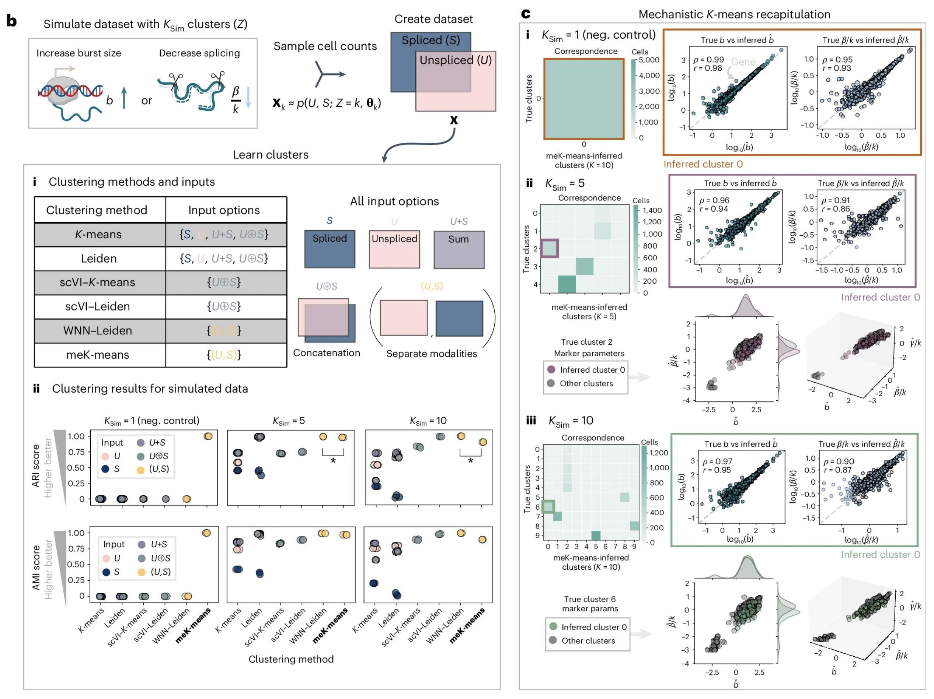
meK-means’ performance on simulated datasets
Notes:
c) meK-means infers transcription parameters well
Only meK-means converges to 1 cluster for bii ksim = 1
ARI: adjusted rand index, similarity between 2 clustering assignments (presumably between known given simulation and what method spits out), 1 is perfect assignment, 0 is random, -1 is complete disagreement
AMI: also 1 for perfect agreement, 0 is random
Sum is just adding U and S counts/gene, concatenate is 1 modality but essentially ”doubling # of genes” as you have gene_1_unspliced and gene_1_spliced…, then can also have them as 2 modalities separately
test all possible input matrix options: U, S, U+S, U⊕S. The U+Soption represents the summation of the individual U and S matrices (see Fig. 2b, (i)); U⊕S represents the concatenation of the U and S matrices (as used for scVI); and (U, S) denotes the treatment of each modality as its own matrix
Parameters for gene markers, with increased burst size b or decreased splicing β/k, selected for states. Counts sampled for each state to make input data X. i, Table of clustering methods tested with possible data input options. ii, ARI and AMI scores for each method, n = 3 runs, compared with true clusters, across possible inputs for the simulations (with 1, 5 or 10 simulated clusters). For methods with a K hyperparameter, the same K as the data was used; otherwise, the default Leiden resolution parameter was used. *P < 0.05 from a one-sided t-test (3.6 × 10^{–195} for and 8 × 10^{–57} for ). neg., negative. c, i (left): correspondence plot between meK-means-inferred clusters and true clusters for the negative control simulation. Values denote overlapping cell counts. i (right): correlation of the burst size and splicing rates across genes, to the true parameters, shown for the boxed cluster. ii, Same plots as c (i) shown for the simulation. For true cluster 2, the inferred parameters from the corresponding cluster (inferred cluster 0) are shown in 2D and 3D space (including degradation γ/k), with distributions for burst size and splicing rate of the markers. iii, Same plots as c (ii) for the simulation. Marker plots shown for inferred cluster 0 (true cluster 6). All parameter values are shown in log₁₀; denotes the inferred parameter. The dashed lines are the identity line (y = x).
To test the performance of meK-means on datasets with ground-truth clusters, we simulate clusters from the model of transcription in Fig. 2a, where marker genes for each of the clusters were perturbed through increased burst size or decreased splicing rate (Fig. 2b). By modulating burst size and splicing we induce changes in unspliced and spliced counts, and test the detection limits of the clustering methods. These rates define a probability distribution over unspliced (U) and spliced (S) molecules from which a dataset X is sampled (see equation (1)), containing U and S count matrices.
We tested three simulated datasets with , sampling 5,000 cells over a range of cluster sizes (see the ‘Generating simulation data’ section in the Methods); represents a negative control with one cluster. All clustering methods (Fig. 2b, (i)) were run three times, with adjusted Rand index (ARI) and adjusted mutual index (AMI) scores used to assess cluster assignments versus the ground truth. An ARI score of 1.0 denotes overlapping assignments and 0.0 represents poor or random assignments, whereas an AMI score of 1.0 denotes identical assignments and 0.0 represents when the mutual information between assignments is effectively due to chance.
For the negative control simulation, , only meK-means converged on one cluster (Fig. 2b, (ii)). All other methods converged on a range of (non-overlapping) clusters (Supplementary Fig. 3a). This suggests the other cluster assignments were driven by noise and do not reveal some discernible structure. For the two remaining datasets, WNN–Leiden was the only method that was significantly better (P-value < 0.05) than meK-means on both datasets, with an average ARI of 1.0 versus 0.99 on , and 1.0 versus 0.91 on . For , the worst-performing methods were Leiden and K-means with S(ARI < 0.5) and MOFA+–Leiden (ARI = 0.5). However, MOFA+–Leiden demonstrated ARI scores near 1.0 for , whereas GLUE–Leiden was near the bottom (average ARI = 0.59) alongside Leiden and K-means with S (ARI < 0.5). Overall, meK-means was the most consistent on all simulations.
Mechanistic K-means also maintained high ARI and AMI scores across a range of Khyperparameter values, and with increasing amounts of random noise (dropout) (see the ‘Generating simulation data’ section in the Methods, and Supplementary Fig. 3c,d). For data with 1 or 5% added dropout, ARIs on average were 0.8 or above (or greater than 0.65 for the 20% added dropout data) for the best meK-means fits. We note that this random dropout is in addition to dropout simulated from length-biased sampling. Importantly, without knowledge of true cluster labels, we used Akaike Information Criterion (AIC) scores (a likelihood-based metric of model fit and quality) to determine the most accurate meK-means fits. For other clustering methods, such metrics are not present or provided, making it difficult for users to ascertain which clustering is better.
In addition to clustering accuracy, meK-means also recovered the biophysical (Fig. 2c, (i)–(iii)) and technical sampling parameters (Supplementary Fig. 3b) with high correlation. Spearman and Pearson correlations are denoted by ρ and r, respectively. For the inferred parameters for the marker genes of true cluster 2 capture the subtle shifts in burst size and splicing rate as compared with their parameters in other clusters (Fig. 2c, (ii) bottom row), and likewise for markers (Fig. 2c, (iii) bottom row). Thus, even for simulations incurring subtle kinetic shifts, meK-means recovers the correct clusters and parameters.

Slide 7
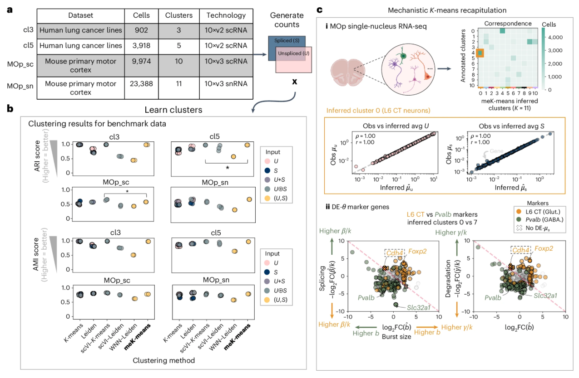
meK-means’ performance on biological datasets
Notes:
benchmark biological datasets with ground truth clusters or clusters from manual curation
two scMixology
datasets21, a mix of three or five human lung adenocarcinoma lines
(3cl and 5cl, respectively), and two Allen Institute mouse primary
motor cortex (MOp) datasets, an scRNA-seq dataset (MOp_sc) and
an snRNA-seq dataset (single-nucleus RNA-seq, MOp_sn)14 (Fig. 3a) Datasets were filtered for highly variable genes (HVGs) with SCANPY39 and then filtered for overdispersed genes with sufficient U, S counts

Slide 8
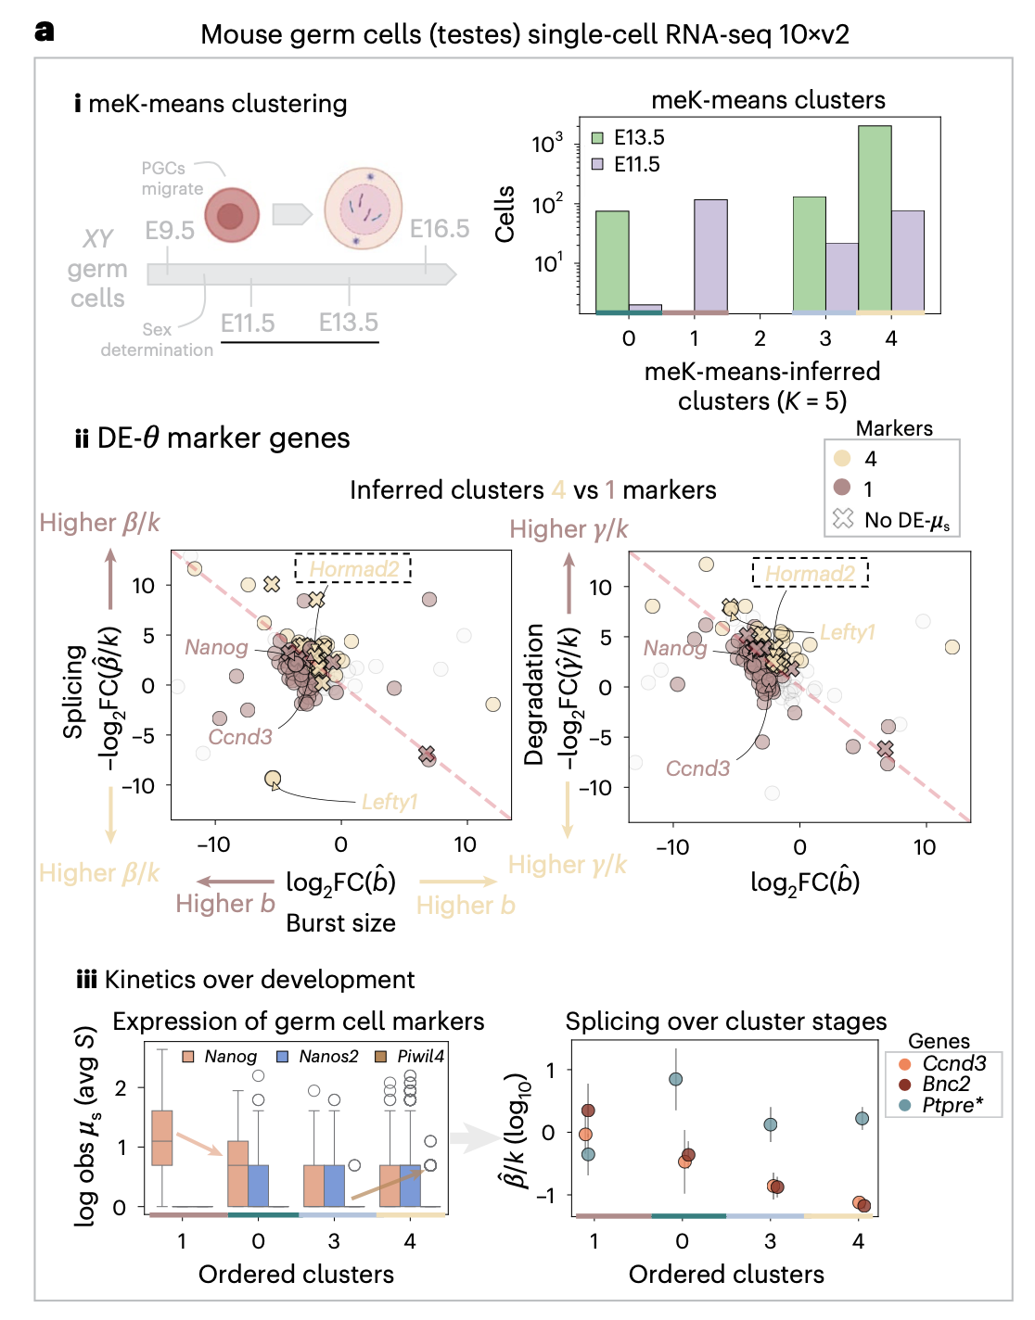
meK-means-based biological discoveries
Notes:
clustered testicular germ
cells from early and later stages of development (E11.5 and E13.5) to
explicitly model dynamics and identify cells in different states of matu-
ration and kinetic regulation28
.
We found four clusters of cells containing differing proportions
of early and later stage cells (Fig. 4a, (i)), using the AIC score to choose
between meK-means results at several values of K (Supplementary
Fig. 7a) (see the ‘Marker gene assessment and rejection statistics’ sec-
tion in the Methods). For data where more heterogeneity is expected,
the AIC also determines when higher K fits are preferable (Supplemen-
tary Fig. 7a,b). In comparing the cluster with the largest number of
E13.5 cells to the cluster of only E11.5 cells (inferred clusters 4 versus 1),
DE-θ analysis extracted the known pluripotency marker Nanog and the
cell-cycle-control-related Ccnd3 gene as early stage markers, both of
which are downregulated in maturing testicular germ cells28 (Fig. 4a, (ii)).
In the E13.5-dominated cluster, Lefty1, a gene associated with axis
specification, displayed lowered burst size but increased splicing and
lowered degradation, whereas Hormad2, a gene implicated in regu-
lating mammalian meiosis47, displayed both decreased splicing and
degradation (suggesting a likely increase in its transcription rate k) in
this cluster, where spliced expression fold change was not discernible
(Fig. 4a, (iii)).
Clusters also demonstrated graded expression of germ cell
maturation markers: displaying decreasing expression of the pluri-
potency marker Nanog, and increasing expression of male-specific
markers in gametogenesis, Nanos2 and Piwil4 (Fig. 4a, (iii) left).
Spermatogenesis-related genes such as Bnc2 and cell-cycle-related
Ccnd3 also showed decreasing splicing over the clusters (Fig. 4a, (iii)
right), matching previous literature on their increased intronic counts/
intron-retention during spermatogenesis28. We also uncovered genes
with increasing splicing dynamics, such as the phosphatase-encoding
Ptpre, which has roles in signal transduction and cell differentiation48
(Fig. 4a, (iii) right). For splicing parameters, we also assess uncertainty
in these estimates, as displayed through the 99% confidence intervals

Slide 9
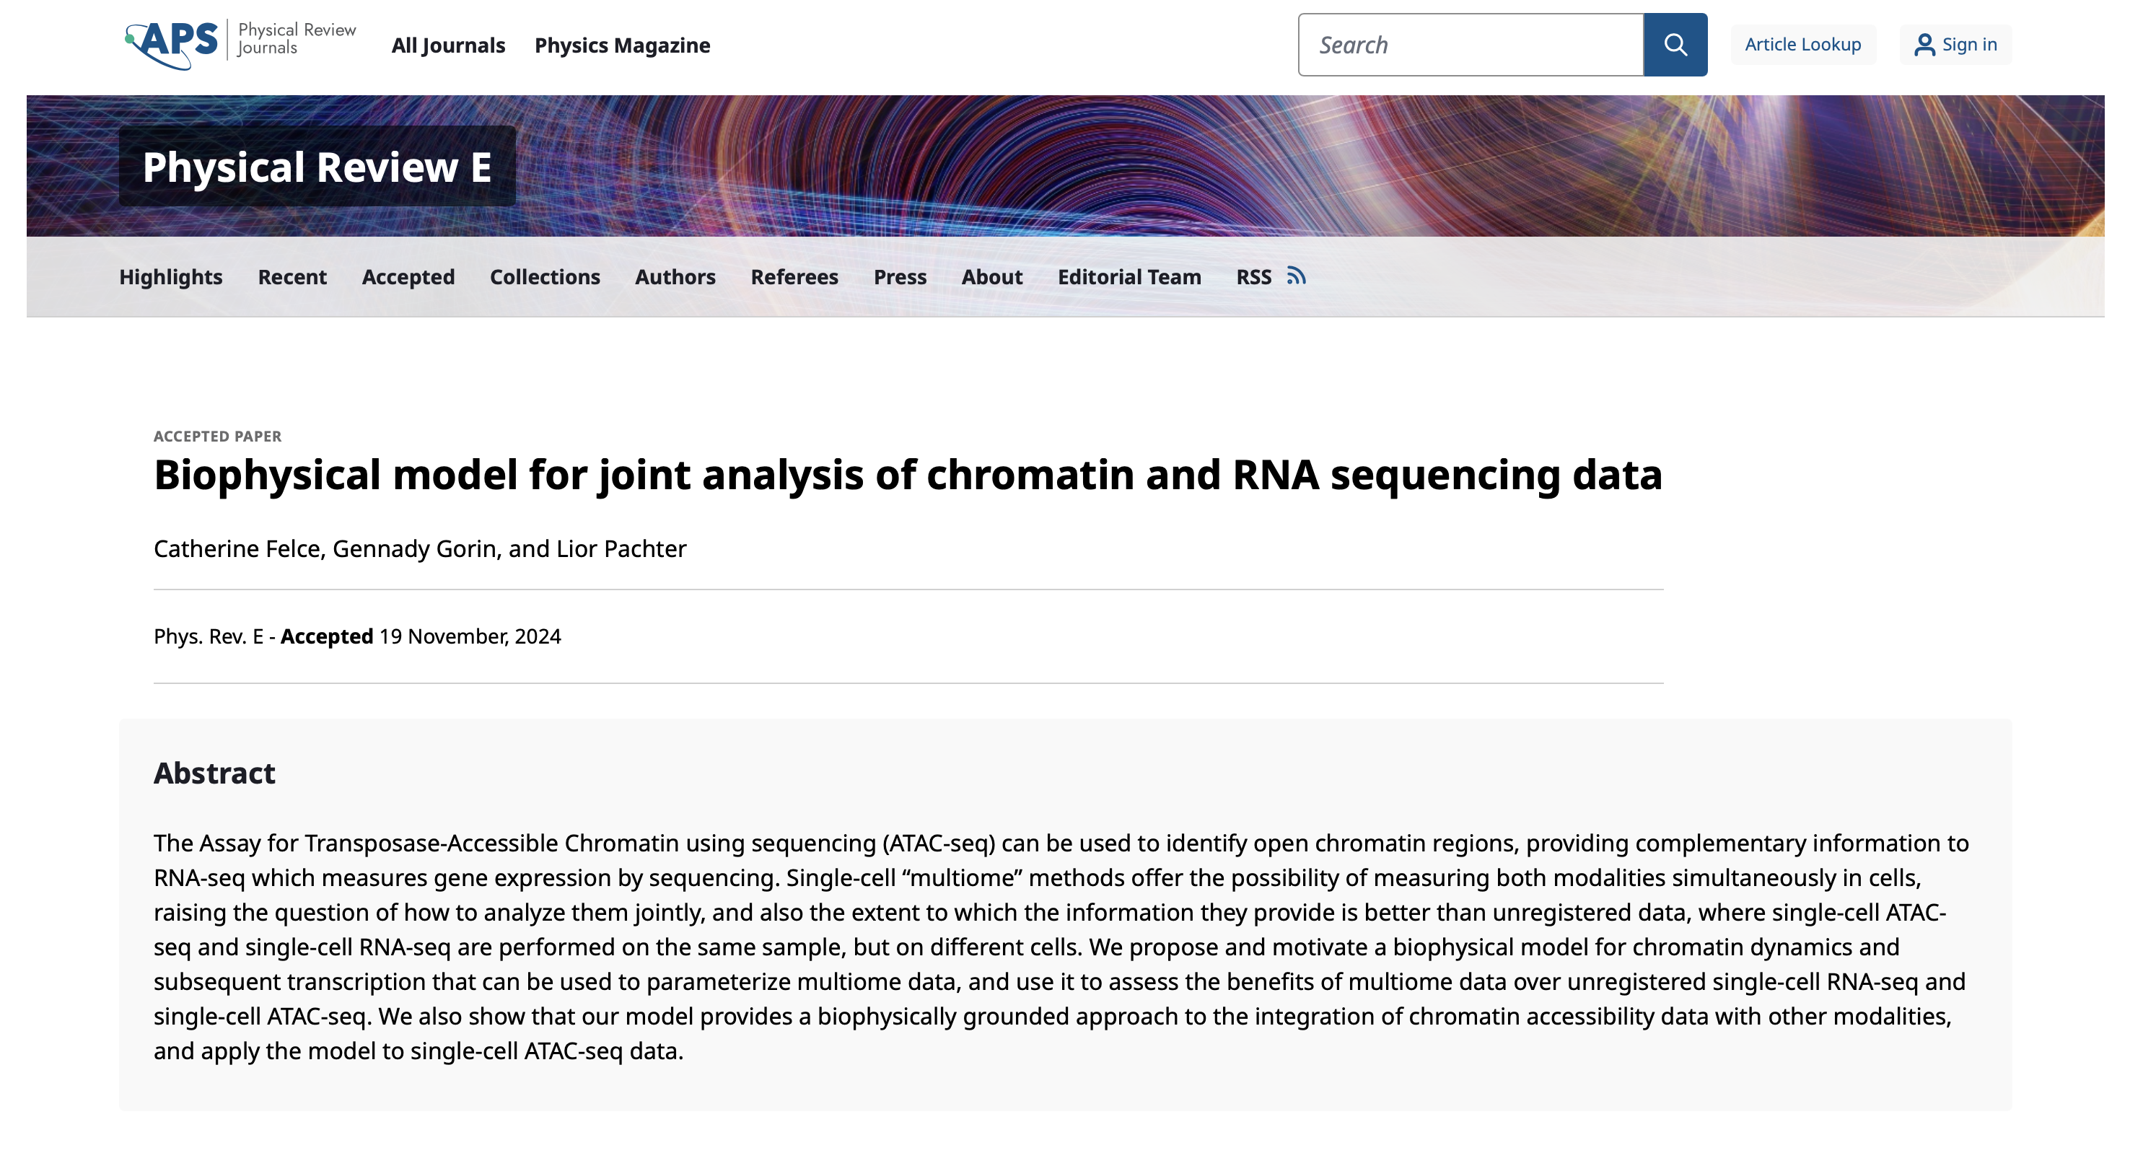
Using meK-means on other groups of modalities
meK-means works on unspliced and spliced RNA counts
ideally would be able to use meK-means on paired ATAC + RNA, paired RNA + proteomics, would just need to edit use of CME…?
Notes:
The CME model underlying meK-means can also be consistently
extended to include other popular readouts such as chromatin acces-
sibility and protein expression7 ,36,63. Such extensions are particularly
exciting given developments in unbiased sequencing technologies,
for example, random primer-based44 or long-read sequencing45, which
improve retention of transcripts in various states of processing. Data
from multiple batches could also be incorporated into meK-means,
where technical sampling parameters are set a priori for each batch (see
Supplementary Fig. 3b) and cluster-specific biophysical parameters
are learned across all cells.
In reviewer comments they say that CME has been used for ATAC/RNA, unclear how to apply that methodologically here though…

Slide 10
Suggested use cases
When biologist is expecting/interested in clusters defined by unique transcriptional bursting, splicing, and/or mRNA degradation dynamics… (rather than just mature) mRNA expression, when interested in if gene expression is higher due to higher transcription and/or reduced degradation
Potentially in stress responses (transcriptional bursting changes), cancer (splicing dysregulated), inflammation (RNA degradation changes), acute time course experiments (drug treatments)

Slide 11
Using meK-means on (un)spliced RNA counts from P384-4
run velocyto to get U,S from BRI data (as loom files)
integrate loom files across patients
run meK-means on integrated loom file with U,S counts
Notes:
Users must also provide a K-value (or a small range of K-values)
to meK-means to be tested
Likelihood-based metrics such as AIC
(Supplementary Figs. 3d and 7a) can also be used to determine which
K-value provides the best meK-means fit. Mechanistic K-means can
also converge to fewer than K clusters, making this a more conserv-
ative approach than other techniques.
Velocyto scans the aligned reads and classifies them as either:
Spliced Reads: Reads that map to exon-exon junctions (indicating mature mRNA).
Unspliced Reads: Reads that map to introns (indicating pre-mature mRNA).
Counting Spliced and Unspliced Reads:
For each gene, Velocyto counts:
Spliced Counts (mature mRNA).
Unspliced Counts (pre-mature mRNA).
Generate a .loom File:
The spliced and unspliced counts are stored in a .loom file, which is a specialized file format for large, sparse matrices.
The .loom file is then used in downstream RNA velocity analysis.

